Slide 1
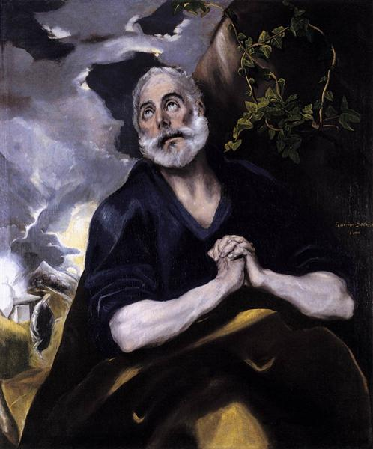
And Peter remembered the word of Jesus, which said unto him, Before the cock crow thou shalt deny me thrice. And he went out and wept bitterly.
Matthew 26.15
He saith unto him the third time, Simon, son of Jonas, lovest thou me? Peter was grieved because he said unto him the third time, Lovest thou me? And he said unto him, Lord, thou knowest all things; thou knowest that I love thee. Jesus saith unto him, Feed my sheep.
John 21. 17
The penitent St Peter; El Greco 1541 – 1614.
The Bowes museum

